Slide 1
Email Marketing
Duane Reading ~ Outdoor Adventure Marketing
duane.reading@oam-mail.com
801 573 4460
outdooradventure-marketing.com
Notes:
Me
History of OAM

Slide 2
95% of online consumers have an email account
95%

Slide 3
74% of consumers prefer to receive commercial communications via email
74%

Slide 4
76% of email opens occur in the first two days after an email is sent
76%

Slide 5
91% of consumers check their email daily
91%

Slide 6
For every $1 spent, $44.25 is the average return on email marketing investment
4,425%
The reason to use email at all is:
New clients
Keep the clients you have coming back.
Let's say you invest $2,400 a year in email, using a service like OAM.
To generate 4,425% ROI it would require you to sell 20 - $5,000 packages that you would not have sold otherwise.
Sell just 5 - $5,000 packages and the ROI is 104%

Slide 7
Most types of marketing and advertising are difficult to measure
With email, everything can be tracked
See who clicked on certain links and much more

Slide 8
Email Marketing in it's Simplest Form
Step 1: Choose an Email Provider
Step 2: Build Your List of Email Addresses
Step 3: Use Template and Write Your Email
Step 4: Choose Your Recipients
Step 5: Send Your Email Blast
Step 6: Refine and Repeat

Slide 9
If we stop right here and you all start an email program at your lodge this will have been worth the time.
Email Providers
Aweber
Constant Contact
iContact
Mail Chimp
Email References
Use the resources and blogs of the provider you use
Random survey of 32 Endorsed Lodges,
60% had an email sign-up link on home page. I sign-up for all and in 14 days have
received 6 welcome emails and 4 newsletters.

Slide 10
Some Dos and Don'ts
Get the free trial images off your emails.
The Constant Contact logo or the "Try it for FREE" tag line from your email footers can be removed from your email. However, Constant Contact support representatives must do this for you. In order to have Customer Support remove these things from your emails please contact support. Although there is no fee for this service, you must be a paying Constant Contact customer. If you are a trial customer, you must become a paying customer to have this service performed. If you want to add your company logo in place of the Constant Contact logo, there will be a customization charge.
Don't use your personal email address like aol.com or yahoo.com when sending emails from your business.
Learn to use a photo editor and make your images consistent and the right size for your email template.
Limit information asked on sign-up, you only need email and name to get started.

Slide 11
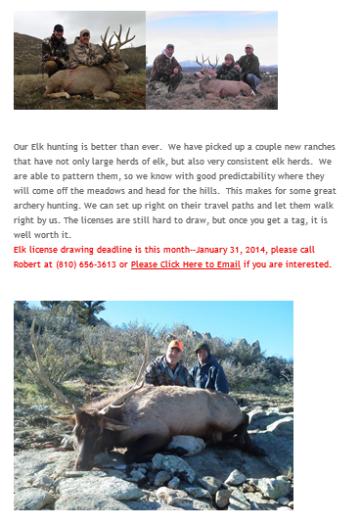

Slide 12
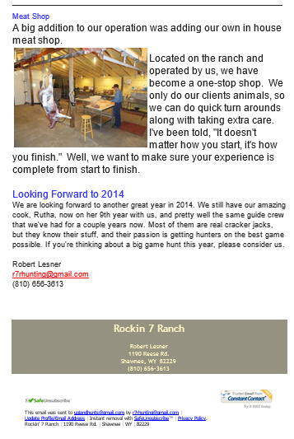

Slide 13
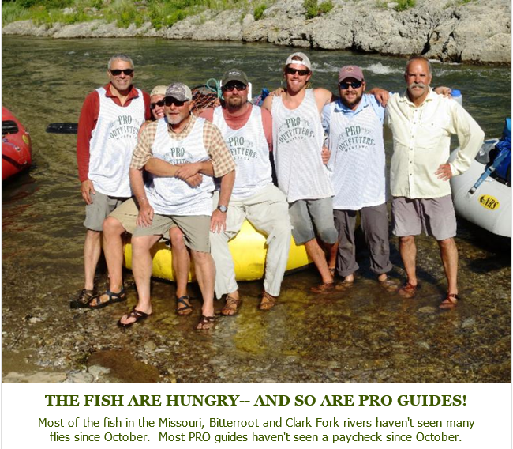
One of the most common mistakes in email marketing is not seeing it as an engagement tool
Don't just sell, engage, entertain, educate.

Slide 14
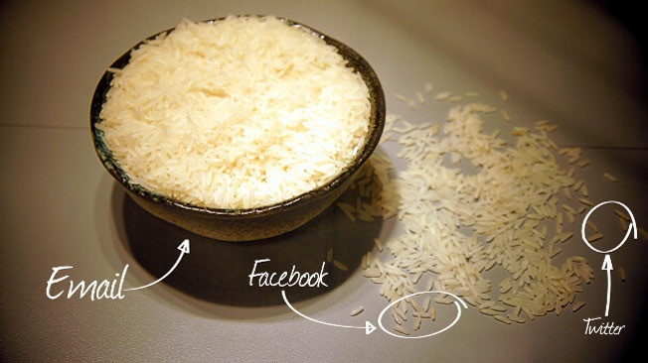

Slide 15
Any Questions so far?

Slide 16
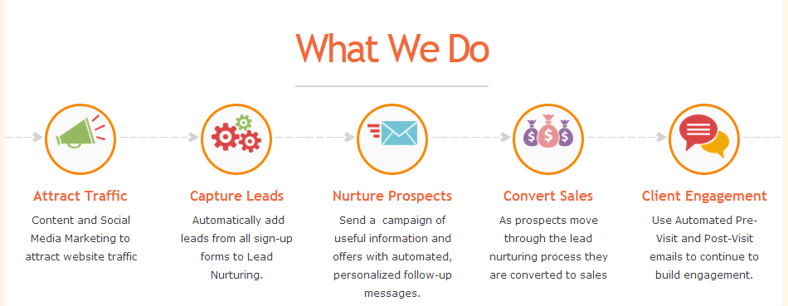
Lifecycle Email Marketing

Slide 17
Attract
What are you doing to to attract website traffic?

Slide 18
Capture
Automatically add leads from all sign-up forms to Lead Nurturing platform.
Website - Facebook - Trade Shows

Slide 19
Nurture
Send a series of useful information and offers with automated, personalized follow-up messages.

Slide 20
What is Lead Nurturing?
A key aspect of lead nurturing is the ability to provide valuable education and information to prospects up front, to become a trusted adviser.
You are then perceived to be an expert. You don’t sell, you don’t make pitches.
Instead, you provide insights and solutions, all within the realm of your expertise and thus become the first they call when there’s a need.

Slide 21
A Simple Welcome Email
A study by Experian showed that welcome emails are opened 4x as often as normal run of the mill emails. Triggered welcome emails generate 5x as many clicks and 8 times as much revenue.
Only 57.7% of companies greet new subscribers with a welcome email

Slide 22
Why Nurture?
Because 73% of the prospects visiting your website today are there to research
As many as 60% of them will eventually book a trip with you or your competitor.

Slide 23
Lead Scoring
During the lead nurturing process, the prospects is scored on their engagement and handed to sales at the time they seem most likely to make a decision to book a trip and become a client.

Slide 24
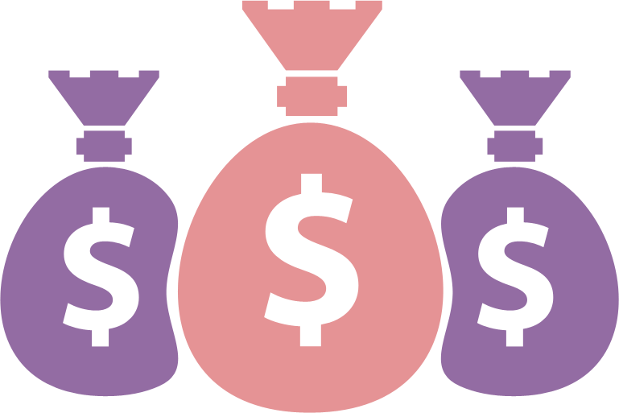
Convert
As prospects move through the lead nurturing process they are converted to clients by your sales team.

Slide 25
Engage Your New Clients
Use Automated Pre-Visit and Post-Visit emails to continue to build engagement.
Then use other tactics to keep them engaged.
Newsletters
Birthday Campaigns

Slide 26
Segment
Move your newly acquired clients on to one list and keep a list of people you are still nurturing.
Over time you will want to start a re-engagement campaign with leads that have gone cold.

Slide 27
Mobile Email
Mobile now makes up the majority of email opens at 51%
Only 11% of emails are optimized for mobile
69% of mobile users delete emails that aren't optimized for mobile
25% of emails are opened on iPhones

Slide 28
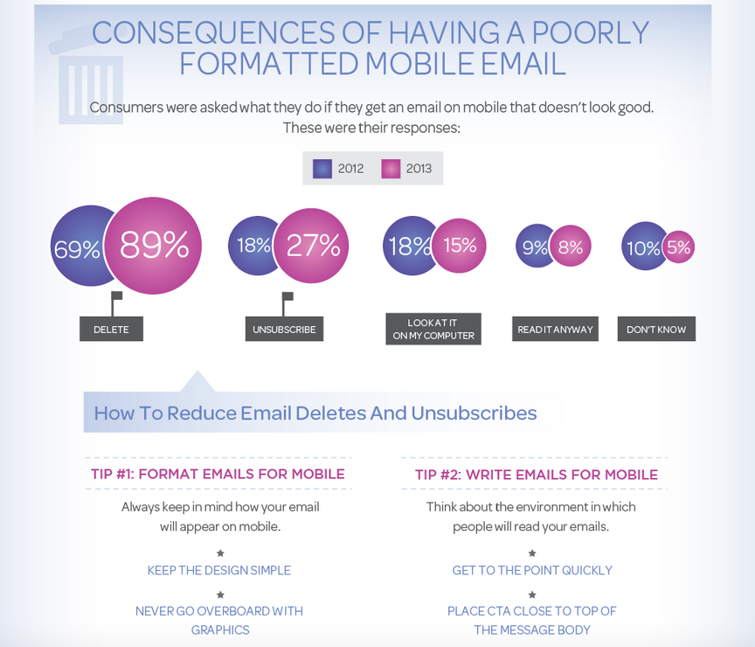

Slide 29
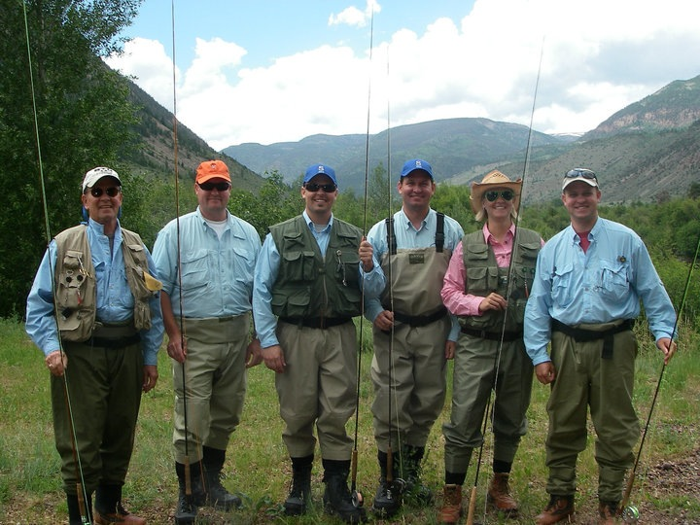
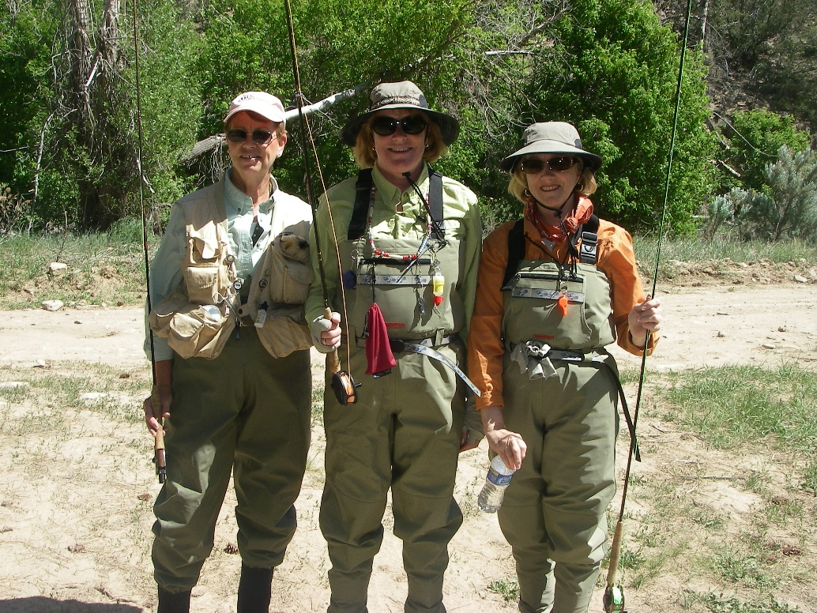
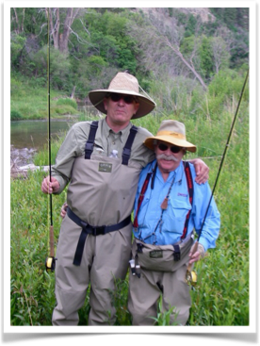
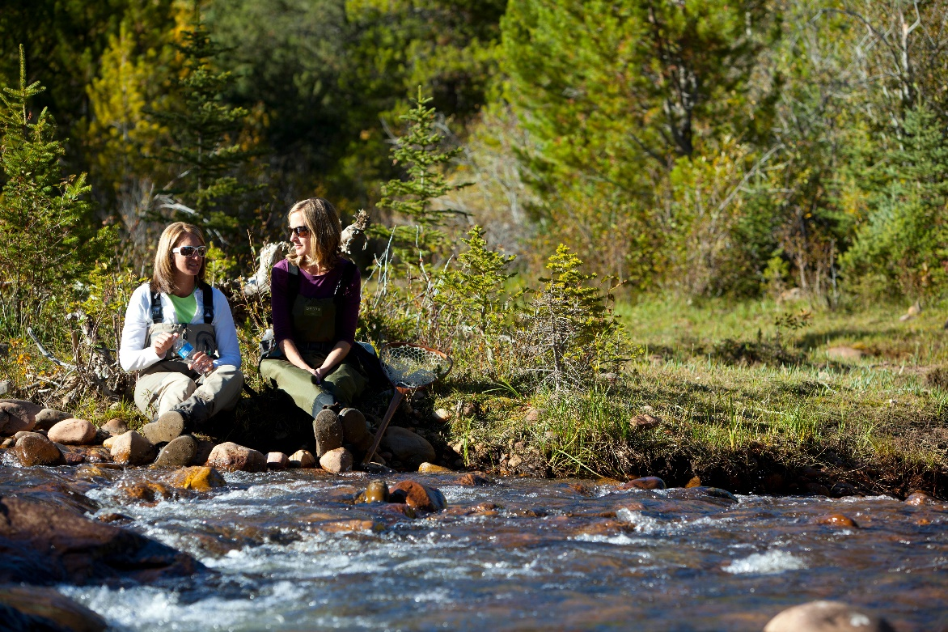
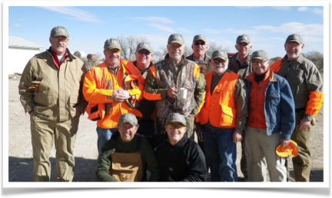
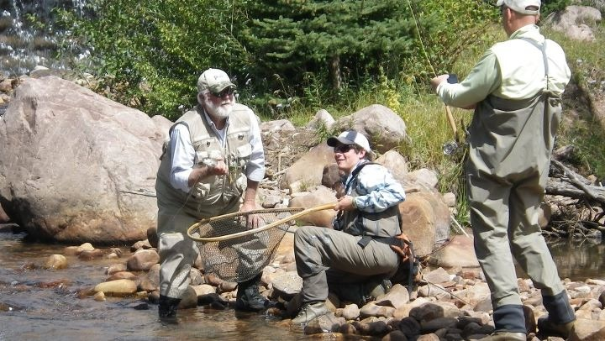

Slide 30
Q & A

Slide 31
Thank You
Duane Reading
duane.reading@oam-mail.com
801 573 4460
outdooradventure-marketing.com

